Slide 1
A History of QSP/QSVT
Sharan Krishnan

Slide 2
Overview
2016: The methodology of resonant equiangular composite quantum gates
2016: Optimal Hamiltonian Simulation by QSP
2016: Hamiltonian Simulation by Qubitization
2018: Quantum Singular Value Transform
2024: Generalised QSP
Other relevant work

Slide 3
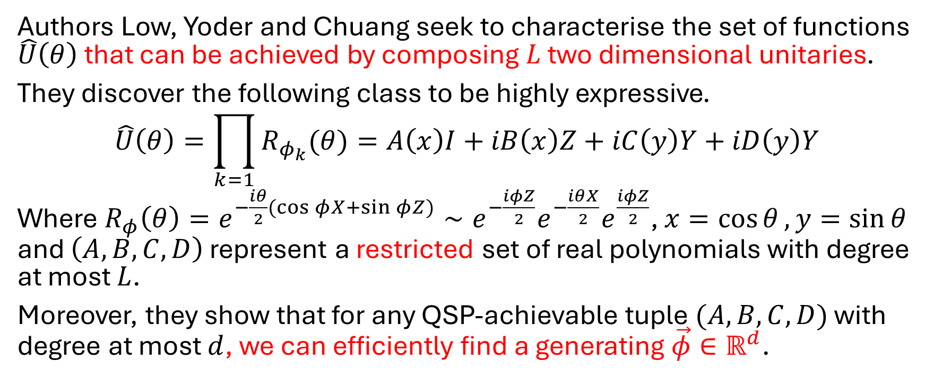
2016: The methodology of resonant equiangular composite quantum gates
Authors Low, Yoder and Chuang seek to characterise the set of functions $\hat{U}\left(θ\right)$ that can be achieved by composing $L$ two dimensional unitaries.
They discover the following class to be highly expressive.
$$\hat{U}\left(θ\right)=\prod_{k=1}{R_{φ_{k}}(θ)}=A\left(x\right)I+iB\left(x\right)Z+iC\left(y\right)Y+iD\left(y\right)Y$$
Where $R_{φ}\left(θ\right)=e^{−\frac{iθ}{2}(\cos{φ}X+\sin{φ}Z)}∼e^{−\frac{iφZ}{2}}e^{−\frac{iθX}{2}}e^{\frac{iφZ}{2}}$, $x=\cos{θ},y=\sin{θ}$ and $\left(A,B,C,D\right)$ represent a restricted set of real polynomials with degree at most $L$.
Moreover, they show that for any QSP-achievable tuple $(A,B,C,D)$ with degree at most $d$, we can efficiently find a generating $\vec{φ}∈ℝ^{d}$.

Slide 4

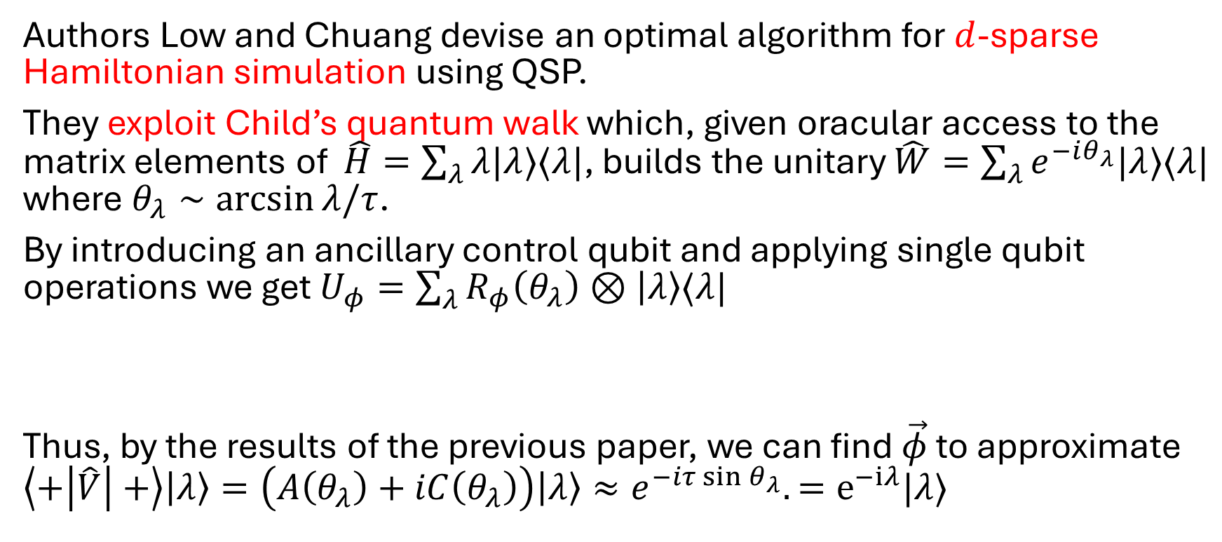
2016: Optimal Hamiltonian Simulation by QSP
Authors Low and Chuang devise an optimal algorithm for $d$-sparse Hamiltonian simulation using QSP.
They exploit Child’s quantum walk which, given oracular access to the matrix elements of $\hat{H}=\sum_{λ}{λ|λ⟩⟨λ|}$, builds the unitary $\hat{W}=\sum_{λ}{e^{−iθ_{λ}}|λ⟩⟨λ|}$ where $θ_{λ}∼\arcsin{λ/τ}$.
By introducing an ancillary control qubit and applying single qubit operations we get $U_{φ}=\sum_{λ}{R_{φ}\left(θ_{λ}\right)⊗\left|λ\right\rangle ⟨λ|}$
Thus, by the results of the previous paper, we can find $\vec{φ}$ to approximate $\left\langle +\left|\hat{V}\right|+\right\rangle \left|λ\right\rangle =\left(A\left(θ_{λ}\right)+iC\left(θ_{λ}\right)\right)\left|λ\right\rangle ≈e^{−iτ\sin{θ_{λ}}}.=e^{−iλ}|λ⟩$

Slide 5
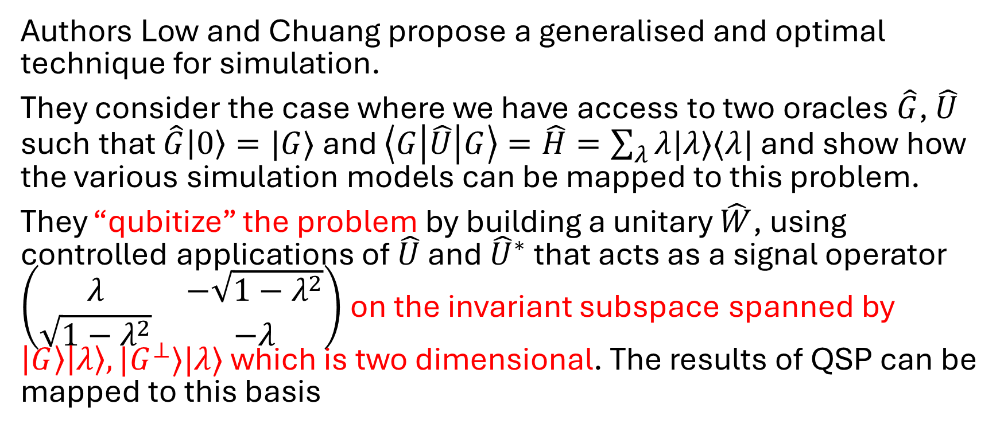
2016: Hamiltonian Simulation by Qubitization
Authors Low and Chuang propose a generalised and optimal technique for simulation.
They consider the case where we have access to two oracles $\hat{G}$, $\hat{U}$ such that $\hat{G}\left|0\right\rangle =|G⟩$ and $\left\langle G\left|\hat{U}\right|G\right\rangle =\hat{H}=\sum_{λ}{λ|λ⟩⟨λ|}$ and show how the various simulation models can be mapped to this problem.
They “qubitize” the problem by building a unitary $\hat{W}$, using controlled applications of $\hat{U}$ and ${\hat{U}}^{∗}$ that acts as a signal operator $\left(\begin{matrix}λ & −\sqrt{1−λ^{2}} \\ \sqrt{1−λ^{2}} & −λ\end{matrix}\right)$ on the invariant subspace spanned by $\left|G\right\rangle \left|λ\right\rangle , |G^{⊥}⟩|λ⟩$ which is two dimensional. The results of QSP can be mapped to this basis

Slide 6
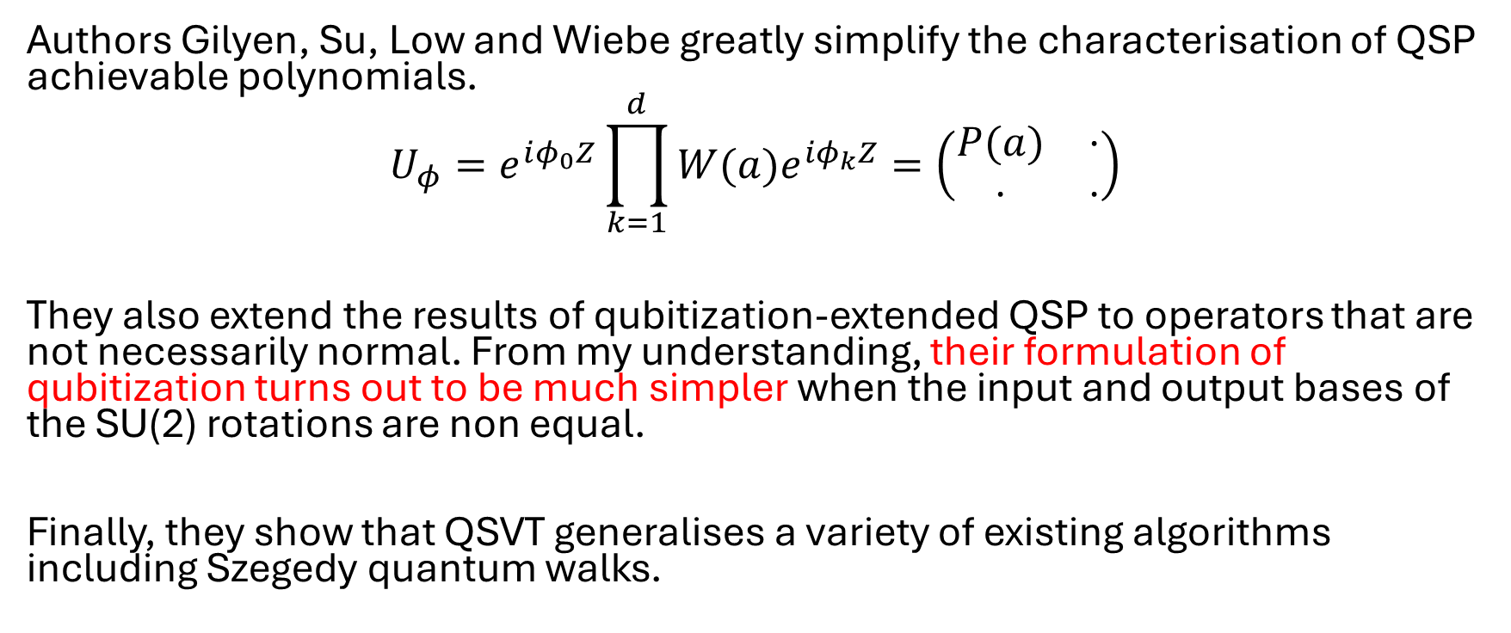
2018: Quantum Singular Value Transform
Authors Gilyen, Su, Low and Wiebe greatly simplify the characterisation of QSP achievable polynomials.
$$U_{φ}=e^{iφ_{0}Z}\prod_{k=1}^{d}{{W(a)e}^{iφ_{k}Z}}=\left(\begin{matrix}P(a) & ⋅ \\ ⋅ & ⋅\end{matrix}\right)$$
They also extend the results of qubitization-extended QSP to operators that are not necessarily normal. From my understanding, their formulation of qubitization turns out to be much simpler when the input and output bases of the SU(2) rotations are non equal.
Finally, they show that QSVT generalises a variety of existing algorithms including Szegedy quantum walks.

Slide 7



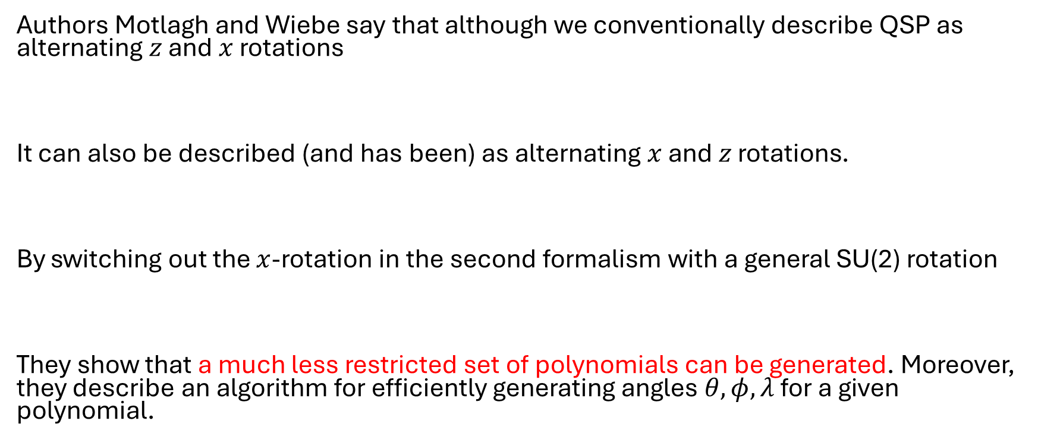
2024: Generalised QSP
Authors Motlagh and Wiebe say that although we conventionally describe QSP as alternating $z$ and $x$ rotations
It can also be described (and has been) as alternating $x$ and $z$ rotations.
By switching out the $x$-rotation in the second formalism with a general SU(2) rotation
They show that a much less restricted set of polynomials can be generated. Moreover, they describe an algorithm for efficiently generating angles $θ, φ,λ$ for a given polynomial.

Slide 8
Other papers
2021: “Grand unification of Quantum Algorithms” is published by Martyn, Rossi, Tan and Chuang which gives a simplified (albeit less general) tutorial on how the results of QSVT and its applications can be derived
2023: “A CS guide to QSVT” is published by Tang and Tian gives a proof of the correctness of QSVT without reliance on qubitization. Claiming the alternate proof is easier to follow. They also show that Chebyshev Polynomials alone (a type of QSP achievable polynomial) is expressive enough to well approximate any function that can be well approximated by a QSP achievable polynomial.
2024: “A case study against QSVT” by Greenaway, Pol and Sim demonstrate that when applied to QPE, QSVT techniques underperform existing art.

Slide 9

$\hat{U}= \begin{matrix}H & ⋅ \\ ⋅ & ⋅\end{matrix}$
$U:H_{a}⊗H_{s}→H_{a}⊗H_{s}$
$B=\left\{ \right|G⟩, |G_{i}⟩\}_i$
Input: U, G: <G|U|G> = H
Output: e^{-itH}

